Slide 1
Chapter 1-2

Slide 2
Topics in Chapter
1.1 Why take this course ?
1.2 Classes of computers in current computer market
1.3 Defining computer architecture and What’s the task of computer design?
1.4 Trends in Technology
1.5 Trends in power and Energy in Integrated circuits
1.6 Trends in Cost
1.7 Dependability
1.8 Measuring, Reporting and summarizing Perf.
1.9 Quantitative Principles of computer Design
1.10 Putting it altogether

Slide 3
Trends in Power
Power also provide challenges as device scaled
first microprocessor: 1/10watt -->
2GHz P4: 135watt
Challenges:
distributing the power
removing the heat
preventing hot spot

Slide 4
Techiques to save engery
Do nothing well----stop the clocks when cores are idle.
Dynamic Voltage – Frequency Scaling (DVFS)
A few clock frequency and voltages
Design for typical case
Lower power modes（LPM） –save power
Can not access DRAM or disk when in LPM
Overlocking
Turn off all cores but one and run at higher clok rate.
Race-to-halt
Use a faster， less energy-efficient processor to allow the rest of the system to into a sleep mode

Slide 5
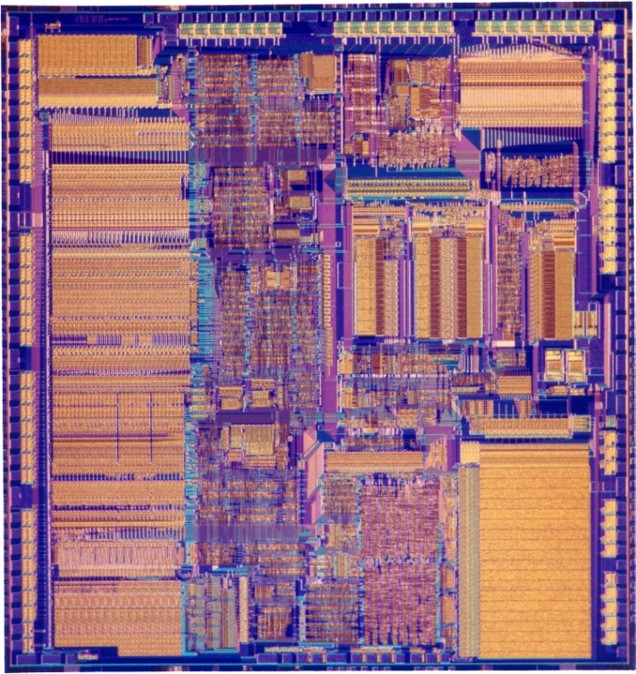
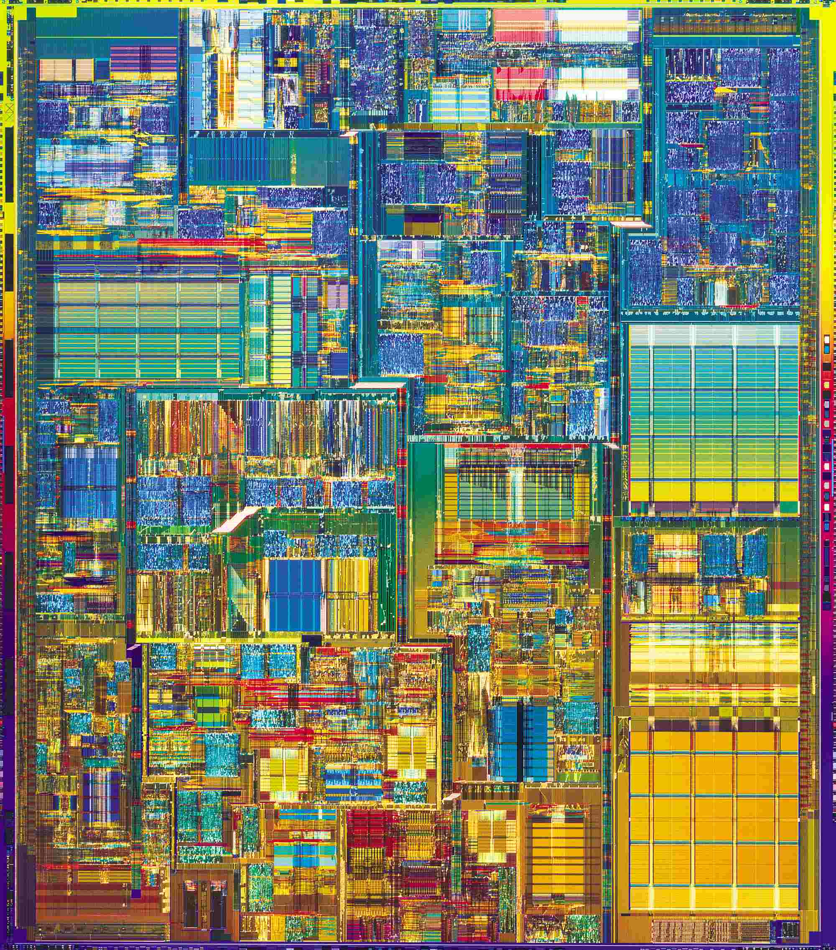
Compare the performance / power
Pentium® 4 Processor
386 Processor
May 1986
@16 MHz core
275,000 1.5µ transistors
~1.2 SPECint2000
17 Years
200x
200x/11x
1000x
August 27, 2003
@3.2 GHz core
55 Million 0.13µ transistors
1249 SPECint2000

Slide 6
Power efficiency
Power efficiency has dropped
Performance scales with area**.5

Slide 7
Two concepts
Dynamic power: power consumption in switching transistors.
Power _{dynamic} = ½ *Capacitive load * Voltage² * Frequency switched
Energy _{dynamic} = Capacitive load * Voltage²
Static power: power consumption when a transistor is off due to power leakage
Power _{static} = current static * Voltage

Slide 8
Rule of Thumb
10% reduction of voltage yields
10% reduction in frequency
30% reduction in power
Less than 10% reduction in performance
Rule of Thumb
Voltage | Frequency | Power | Performance
1% | 1% | 3% | 0.66%

Slide 9
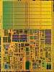
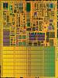
Dual core with voltage scaling
RULE OF THUMB
A 15%
Reduction
In Voltage
Yields
Frequency Reduction | Power Reduction | Performance Reduction
15% | 45% | 10%
SINGLE CORE
DUAL CORE
Area = 1
Voltage = 1
Freq = 1
Power = 1
Perf = 1
Area = 2
Voltage = 0.85
Freq = 0.85
Power = 1
Perf = ~1.8

Slide 10
Multiple cores deliver more performance per watt
Cache
Power
Big core
4
3
Performance
2
2
Small
core
1
1
1
1
Many core is more power efficient
Power ~ area
Single thread performance ~ area**.5
C1
C2
4
4
Cache
3
3
C3
C4
2
2
1
1

Slide 11
Why Multicore?

Slide 12
Topics in Chapter
1.1 Why take this course ?
1.2 Classes of computers in current computer market
1.3 Defining computer architecture and What’s the task of computer design?
1.4 Trends in Technology
1.5 Trends in power in Integrated circuits
1.6 Trends in Cost
1.7 Dependability
1.8 Measuring, Reporting and summerizing Perf.
1.9 Quantitative Principles of computer Design
1.10 Putting it altogether

Slide 13
Major Theme: Lower Cost
Cost Trend
Understanding cost trends of component is important for designers, since we design for tomorrow !
The impact factors for cost:
Time----Component prices drop over time without major improvements in manufacturing technology
Volume ----Volume decreases cost due to increases in manufacturing efficiency.
Commodification----The competition among the suppliers of the components will decrease overall product cost.

Slide 14
Understanding Cost Trend by Learning Curve

Slide 15
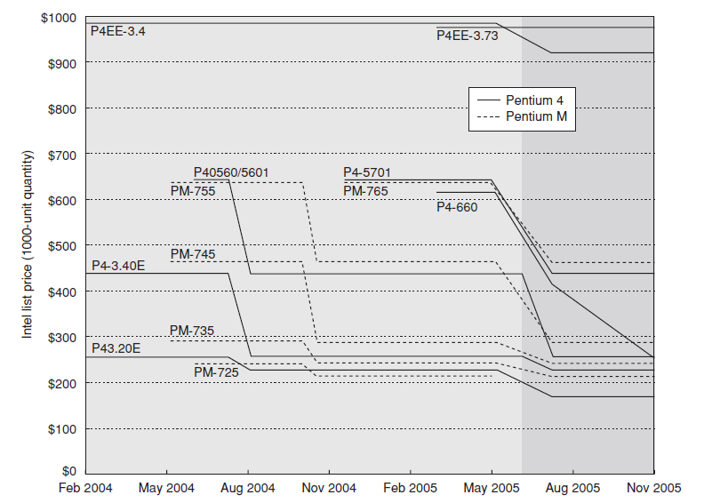
Price of Pentium4 & PentiumM

Slide 16
Rules of Thumb
Time: learning curve ----yield
Twice the yield will have half the cost.(for chip, board, or a system)
Volume:
Cost decrease about 10% for each doubling of volume.
Commodities:
Vendor competition
Supplier competition
Volume increase, however limited profits.
Notes:
Volume affect the cost
缩短了learning curve下拐的时间, 下降的时间与制造的系统数量部分成正比.
提高了购买和制造效率,降低成本
数量会减少开发成本,因为成本是分摊到各台计算机的.
学习曲线（Learning Curve）： 学习曲线是一个用来描述随着生产经验的增加，生产效率提高和单位成本下降的关系图。通常，当生产量翻倍时，单位成本会以一定的百分比下降。这个概念在半导体芯片、印刷电路板或整个系统的生产中尤其重要。
产量（Yield）： 产量指的是在生产过程中成功制造出的合格产品的数量。在半导体制造中，产量特别重要，因为每个晶圆上都会有一定比例的芯片因为制造缺陷而无法使用。提高产量意味着减少浪费，从而降低每个芯片的成本。
产量翻倍成本减半： 这个说法是基于学习曲线理论的一个推论，意味着如果生产量增加一倍，那么单位成本会下降到原来的一半。这通常是因为随着生产量的增加，生产效率提高，固定成本分摊到更多的产品上，从而降低了单位成本。
体积（Volume）： 在经济学中，体积通常指的是生产或销售的数量。根据规模经济原理，当生产体积增加时，单位成本通常会下降。这是因为固定成本（如设备投资、研发费用等）可以在更多的产品上分摊。
成本降低约10%： 这可能是对学习曲线的另一种表述，意味着每当生产量翻倍时，单位成本会下降约10%。这个百分比是经验法则，实际的数字可能会根据不同的行业和生产过程有所不同。
商品（Commodities）： 商品通常指的是那些供应充足、需求价格弹性小、并且通常在市场上以标准化形式交易的产品。商品市场通常竞争激烈，价格主要由供需关系决定。
供应商竞争（Vendor competition）： 供应商竞争指的是供应商之间为了获得市场份额和客户而进行的竞争。这种竞争可以推动价格下降和产品质量的提升。
供应商竞争（Supplier competition）： 这与供应商竞争类似，指的是供应商之间为了成为买家的首选而进行的竞争。这种竞争可以导致更好的采购条件，包括价格和服务质量。
体积增加，然而利润有限： 这可能是指在某些情况下，尽管生产量增加，但由于激烈的市场竞争和商品化，公司可能无法实现高额利润。在这种情况下，公司可能需要通过提高效率和降低成本来维持竞争力。
这些概念在制造业和供应链管理中非常重要，它们帮助企业理解如何通过规模经济和提高效率来降低成本，以及如何在竞争激烈的市场中保持竞争力。

Slide 17
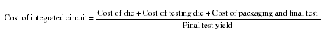
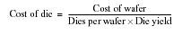
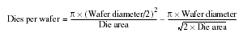
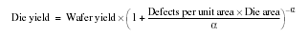
Cost of an Integrated Circuit

Slide 18
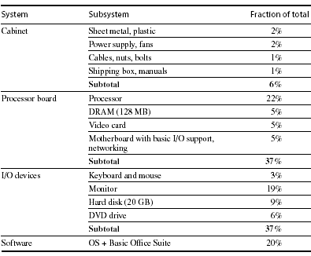
Distribution of Cost in a System

Slide 19
Cost vs. Price
Component costs
Raw material cost.
Direct cost:
Costs incurred to make a single item. Adds 20% to 40% to component cost.
Gross margin ( Indirect cost):
Overhead not associated with a single item, i.e. R&D, marketing, manufacturing equipment, taxes, etc.
Only 4%-12% of income are spent on R&D
Average Selling Price (ASP):
Component cost + direct cost + indirect cost.
List price :
Not ASP. Stores add to the ASP to get their cut. Want 50% to 75% of list price.

Slide 20
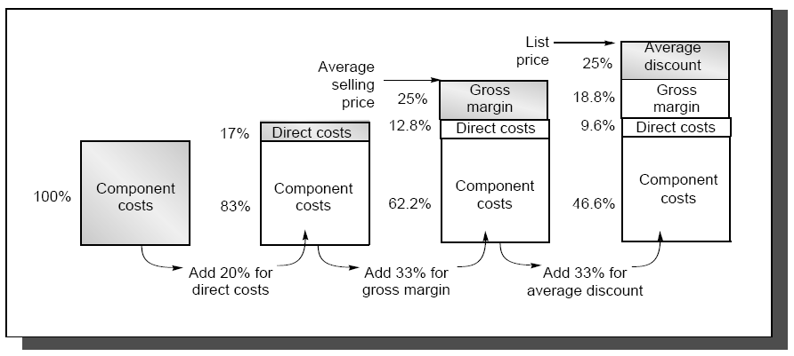
The components of price for a $1000 PC

Slide 21
Cost vs. Price
This gives you insight on how a design decision will affect selling price,
i.e. changing cost by $1,000 increases selling price by $3,000 to $4,000.
Also, consider volume and price relationship:
In general, the fewer computers that are sold, the higher the price.
Also, a decrease in volume causes cost to increase, further increasing price.
Therefore, small changes in cost can have an unexpected large increase in price.

Slide 22
Computer Design Engineering life cycle
Evaluating Existing
Systems for
Bottleneck(app.B)
Benchmarks(1.8)
User requirement
Analysis(1.2)
Quantitative Principles
1.9
Technology Trend 1.4
Power Trend 1,5
Cost Trend 1.6
Application Trend 1,7
Implement Next
Generation System
Simulate New
Designs and
Organizations
Workloads
Evaluating for price peformance(1.8)
Notes:
Requirement Analysis:
Market analysis: who you will sell 4-1.2
desktop, server, embedded system, HPC
Different markets has different driven motivations.
When design a desktop, it aims to obtain best price-performance.
For the servers, dependability is critical, then the scalability, and throughput.
For the embedded computer systems, price is a key factor, while real-time performance is important . And power efficiency and memory size is always under consideration.
2. Functional requirement: 4-1.3
3. Performance requirement:
4. Power
5. Unfuntional requirements: availability, dependibility 1.7
7. Cost/price

Slide 23
Topics in Chapter
1.1 Why take this course ?
1.2 Classes of computers in current computer market
1.3 Defining computer architecture and What’s the task of computer design?
1.4 Trends in Technology
1.5 Trends in power in Integrated circuits
1.6 Trends in Cost
1.7 Dependability
1.8 Measuring, Reporting and summerizing Perf.
1.9 Quantitative Principles of computer Design
1.10 Putting it altogether

Slide 24

Why Business Continuity ?
Lost Productivity
Know the downtime costs (per hour, day, two days...)
Lost Revenue
Number of employees impacted (x hours out * hourly rate)
Direct loss
Compensatory payments
Lost future revenue
Billing losses
Investment losses
Damaged Reputation
Financial Performance
Customers
Suppliers
Financial markets
Banks
Business partners
Revenue recognition
Cash flow
Lost discounts (A/P)
Payment guarantees
Credit rating
Stock price
Other Expenses
Temporary employees, equipment rental, overtime costs, extra shipping costs, travel expenses...
Notes:
adj.赔偿的；弥补的，补偿的

Slide 25
Why high Dependability ?
Millions of US Dollars per Hour in Lost Revenue
Retail
1.1
Insurance
1.2
Information technology
1.3
Financial institutions
1.5
Manufacturing
1.6
Call location
1.6
Telecommunications
2.0
Credit card sales authorization
2.6
Energy
2.8
Point of sale
3.6
Retail brokerage
6.5
Source Meta Group, 2005
Notes:
Retail brokerage
零售经纪

Slide 26
Information Availability(5个9)
% Uptime | % Downtime | Downtime per Year | Downtime per Week
98% | 2% | 7.3 days | 3hrs 22 min
99% | 1% | 3.65 days | 1 hr 41 min
99.8% | 0.2% | 17 hrs 31 min | 20 min 10 sec
99.9% | 0.1% | 8 hrs 45 min | 10 min 5 sec
99.99% | 0.01% | 52.5 min | 1 min
99.999% | 0.001% | 5.25 min | 6 sec
99.9999% | 0.0001% | 31.5 sec | 0.6 sec

Slide 27
Evolvement of Dependability-1
Reliability (可靠性) 1960s
----field of fault tolerance and system reliability
Definition
In general, reliability (systemic def.) is the ability of a person or system to perform and maintain its functions in routine circumstances, as well as hostile or unexpected circumstances.
The IEEE defines it as ". . . the ability of a system or component to perform its required functions under stated conditions for a specified period of time."
The Institute of Electrical and Electronics Engineers

Slide 28
Evolvement of Dependability-2
Dependability (可信性)
1985, Jean-Claude Laprie
J.C. Laprie. "Dependable Computing and Fault Tolerance: Concepts and terminology," in Proc. 15th IEEE Int. Symp. on Fault-Tolerant Computing, 1985
International Conference on dependable Systems and networks
International Symposium on Reliable Distributed Systems
International Symposium on Software Reliability Engineering.

Slide 29
Definition 1 of Denpendability
Computer system dependability is The quality of the delivered service such that reliance can justifiably be placed on this service.
J.C. Laprie. "Dependable Computing and Fault Tolerance: Concepts and terminology," in Proc. 15th IEEE Int. Symp. on Fault-Tolerant Computing, 1985
reliability, maintainability, availability, safety, are quantitative measures corresponding to distinct perceptions of the same attribute of a system: it’s dependability
general concept
Notes:
Error, fault, failure

Slide 30
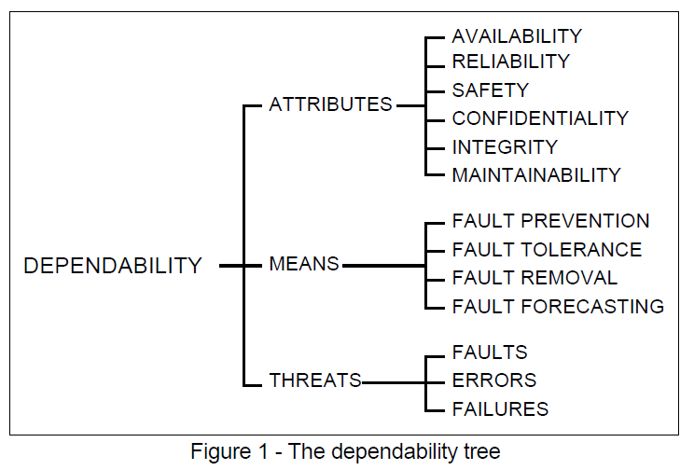
Definition 2 of Denpendability
A. Avizienis, J.-C. Laprie and B. Randell: Fundamental Concepts of Dependability. Research Report No 1145, , April 2001
Denpendability&
Security
Notes:
Error, fault, failure

Slide 31
Related concepts
Availability(可用性) - readiness for correct service
Reliability(可靠性) - continuity of correct service
Safety(平安性?) - absence of catastrophic consequences on the user(s) and the environment
Integrity(完整性) - absence of improper system alteration
Maintainability(可维护性) - ability to undergo modifications and repairs
Confidentiality(机密性), the absence of unauthorized disclosure of information
Security(安全保障) is a composite of Confidentiality, Integrity, and Availability.

Slide 32
Dependability(可信性)
Service level Agreements(SLA) / Service level objectives (SLO)
Service accomplishment
Service interruption
Failures:
S_{accomplishment} →S_{interruption}
Restorations:
S_{interruption} →S_{accomplishment}

Slide 33
Measurements of Dependability
Module reliability: continuous service accomplishment ( of the time to failure )
MTTF: Mean Time To Failure
MTTR: Mean Time To Repair (service interruption)
FIT: Failure In Time = 1/MTTF
MTBF: Mean Time Between Failure = MTTF+MTTR
Module availability
MTTF = MTTF
MTTF + MTTR MTBF

Slide 34
Example: disk system
Assumption:
10 disks, 1000000 hour MTTF
1 SCSI controller, 500000 hour MTTF
1 power supply, 1 fan, both 200000 hour MTTF
1 SCSI cable, 1000000 hour MTTF
Question: MTTR of the whole system
Answer:
Failure rate_{system} = 10*1/1000,000 + 1/500,000 + 1/200,000 + 1/100,000
= 23000/1000,000,000
MTTF_{system} = 1/Failure_{system} = 43500 hours ~ 5 years

Slide 35
Way to cope with failure
Redundancy:
Time redundancy: repeat the operation again to see if it is still in erroneous.
Resource redundancy: have other components to take over from the one that failed.

Slide 36
Dependability
Compare with
Trusted computing
Trustworthy computing
Credibility

Slide 37
Topics in Chapter
1.1 Why take this course ?
1.2 Classes of computers in current computer market
1.3 Defining computer architecture and What’s the task of computer design?
1.4 Trends in Technology
1.5 Trends in power in Integrated circuits
1.6 Trends in Cost
1.7 Dependability
1.8 Measuring, Reporting and summerizing Perf.
1.9 Quantitative Principles of computer Design
1.10 Putting it altogether

Slide 38

Performance

Slide 39
Measuring and Reporting Performance
Comparing Machines
Execution time (latency)
Throughput
MIPS - millions of instructions per second
Comparing Machines Using Sets of Programs
Choosing which program to evaluate performance
Benchmark Suites
Different Means: Arithmetic, Harmonic, and Geometric Means

Slide 40



Defining performance
Performance means different things to different people, therefore its assessment is subtle
different perception
Criteria of performance evaluation differs among users and designers
Just a piece of
cake ! Even for 50 guys
Faint ! When will
they bring me the meal?
Sorry, Lady is first !

Slide 42

Perf. Metrics --response time
Wall-clock time
Start the program and watch the clock -
when the program ends, that’s the total wall-clock time
Also called response time or elapsed time or
Measures user perception of the system speed
Problems with wall-clock time
What if more than one program is running on
the same machine ?
What if the program asks for user input ?

Slide 43
Performance Metrics --CPU time
Measures the time the CPU is computing, (not waiting for I/O)
Measures designer perception of the CPU speed
CPU time is further divided into:
User time - time spent in user mode
System time - time spent in the operating system (OS)
Unix time command reports CPU time as:
90.7u 12.9s 2:39 65%
90.7 user CPU seconds (in the user’s program)
12.9 system CPU seconds (in the system calls e.g. printf)
2 minutes, 39 seconds wall-clock time
65% of the wall clock time was spent running on the CPU

Slide 44
Performance Metrics --throughput
Amount of work done in a given time
Measure administrator perception of the system perf.
We often use throughput to measure
Number of lines of code per day
Number bits per second transmitted over a wire
Number of web pages served
In contrast to latency
amount of time to produce 1 line of code
amount of time to send 1 bit over a wire
Amount of time spent waiting to receive web page
Often, processor performance is only quoted in terms of relative latency
Program A ran 10 times faster than program B
But, for many apps, throughput much more important than latency
Financial markets, government statistics (census)

Slide 45
Response time vs. Throughput
If you improve response time, you usually improve throughput
Replacing the processor of a computer with a faster version
you can also improve throughput without improving response time
Adding additional processors to a system that uses multiple processors
for separate tasks (e.g. handling of airline reservations system)

Slide 46
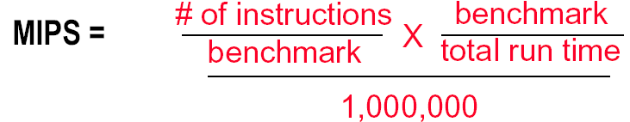
Another industry Metric: MIPS
MIPS - Millions of Instructions per Second
When comparing two machines (A, B) with the same instruction set, MIPS is a fair comparison(sometimes…)
But, MIPS can be a “meaningless indicator of performance…”

Slide 47
Ex: MIPS might be meaningless
Machine A has a special instruction for performing square root calculations. It takes 100 cycles to execute.
Machine B doesn’t have the special instruction -- must perform square root calculations in software using simple instructions (.e.g, Add, Mult, Shift) that each take 1 cycle to execute
Machine A: 1/100 MIPS = 0.01 MIPS
Machine B: 1 MIPS

Slide 48
Another view: Power consumption and Efficiency
Critical factors for embedded systems:
cost
physical size
memory
power consumption
Fig. 1.27
AMD ElanSC520
AMD K6-2E
IBM PowerPC 750CX
NEC VR 5432
NEC VR 4122
The NEC VR 4122 is the big
winner for its best performance/watt,
though it is the second lowest performing processor.

Slide 49
Summary of performance metrics
Response (Execution) time
user perception
system performance
the only unimpeachable measure of performance
CPU time
designer perception
CPU performance
Throughput
administrator perception
MIPS
merchant perception
Notes:
以下是您提供的术语的中文翻译：
1. **响应（执行）时间（Response (Execution) Time）**：
用户请求到系统响应所经历的时间。
2. **用户感知（User Perception）**：
用户对系统性能的主观感受。
3. **系统性能（System Performance）**：
系统在执行任务时的效率和效果。
4. **唯一无可置疑的性能衡量标准（The Only Unimpeachable Measure of Performance）**：
最直接、最客观的性能衡量标准。
5. **CPU时间（CPU Time）**：
CPU执行程序所花费的时间。
6. **设计者感知（Designer Perception）**：
系统设计者对系统性能的理解和预期。
7. **CPU性能（CPU Performance）**：
CPU处理指令和执行任务的能力。
8. **吞吐量（Throughput）**：
单位时间内系统能处理的任务数量或数据量。
9. **管理员感知（Administrator Perception）**：
系统管理员对系统性能的理解和评估。
10. **MIPS（Million Instructions Per Second）**：
每秒百万条指令，衡量CPU性能的指标。
11. **商家感知（Merchant Perception）**：
销售或提供服务的商家对产品或服务性能的看法。

Slide 50
Choose Programs to Evaluate Performance
Ideal performance evaluation:
A random sample of users running their programs and OS commands.
Many different types of benchmarks
Real applications--- Scientific and engineering
Modified (or scripted) applications--- focus on specific features
Kernels --- critical program fragments
Toy --- small programs, often measure very little
Synthetic -- created to represent some aspects of a program (e.g., mix of instruction types)
Database -- a world unto itself
What really matters is how YOUR application performs

Slide 51
Something about Synthetic
Synthetic benchmarks :
Programs that try to "exercise" the system in the same way to match the average frequency of operations and operands of a large set of programs.
Whetstone and Dhrystone.
Similar to kernels but are NOT real programs !
Compiler and hardware optimizations can artificially inflate performance of these benchmarks but not of real programs.
These benchmarks don’t reward optimizations!
SQRT(EXP(x))= √e ^{x} = e ^{x/2} = EXP(X/2)

Slide 52
Notes on performance benchmark
Benchmarks can focus on specific aspects of a system
floating point & integer ALU, memory system, I/O, OS
Universal benchmarks can be misleading since hardware and compiler vendors might optimize their design for ONLY these programs
The best types of benchmarks are real applications since they reflect the end-user interest
Architectures might perform well for some applications and poorly for others
Compilation can boost performance by taking advantage of architecture-specific features. Application-specific compiler optimization are becoming more popular.

Slide 53
SPEC
SPEC - The System Performance Evaluation Cooperative
founded in 1988 by a small number of workstation vendors who realized that the marketplace was in desperate need of realistic, standardize performance tests.
Grown to become successful performance standardization bodies with more than 40 member companies.
http://www.spec.org
SPEC's Philosophy
The goal of SPEC is to ensure that the marketplace has a fair and useful set of metrics to differentiate candidate systems.
The basic SPEC methodology is to provide the benchmarker with a standardized suite of source code based upon existing applications

Slide 54
SPEC benchmarks Desktop Benchmarks
CPU-intensive benchmarks
SPEC89
SPEC92
SPEC95
SPEC2000
SPEC CPU2006 ( 12 CINT2006, 17 CFP2006)
graphics-intensive benchmarks
SPEC2000
SPECviewperf
is used for benchmarking systems supporting the OpenGL graphics library
SPECapc
consists of applications that make extensive use of graphics.

Slide 55
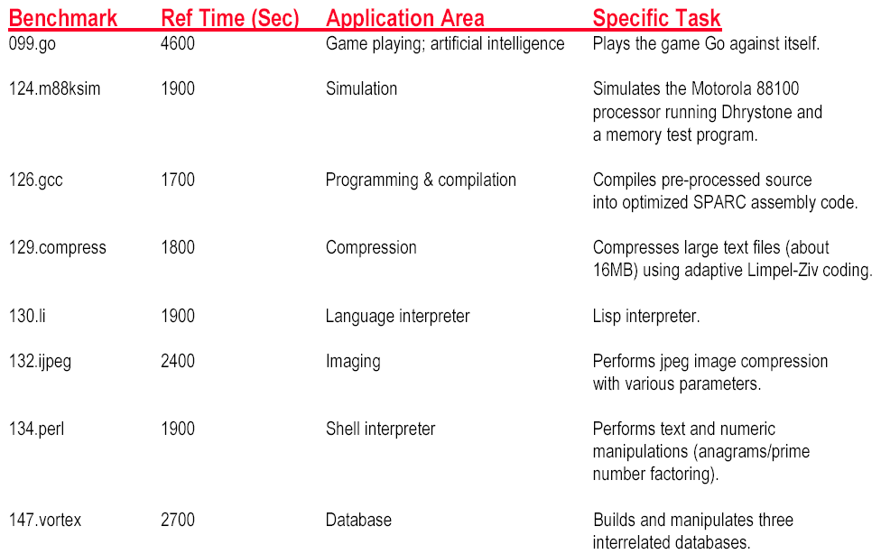
SPEC INT 95 Benchmark descriptions

Slide 56
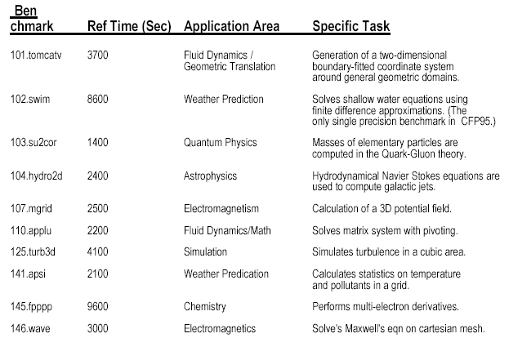
SPEC FP 95 Benchmark Descriptions

Slide 57
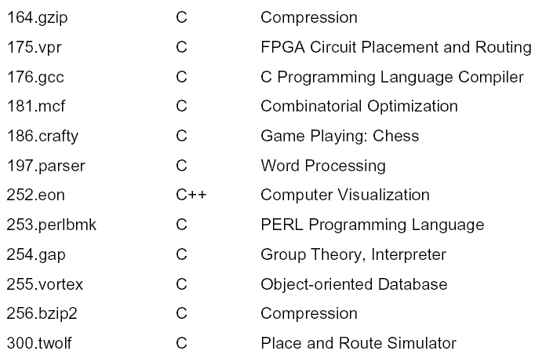
New SPEC Int 2000 Benchmarks

Slide 58
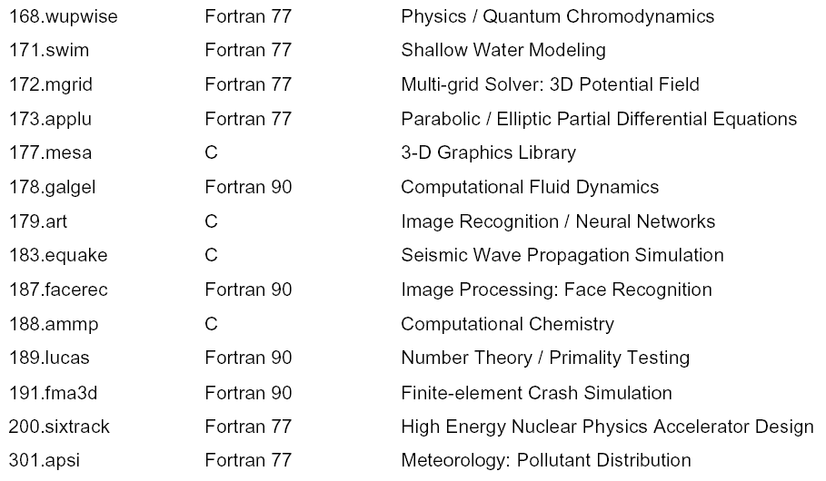
New SPEC FP 2000 Benchmarks

Slide 59
SPEC benchmarks Server Benchmarks
SPECrate--processing rate of a multiprocessor
SPEC CPU2000—throughput-oriented benchmark
SPECrate—processing rate of a multiprocessor
SPECSFS--file server benchmark
SPECWeb--Web server benchmark
Transaction-processing (TP) benchmarks
TPC benchmark—Transaction Processing Council
TPC-A, 1985
TPC-C, 1992,
TPC-H→ TPC-R→TPC-W

Slide 60
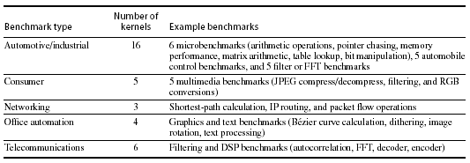
SPEC benchmarks Embedded Benchmarks
EDN Embedded Microprocessor Benchmark Consortium (or EEMBC, pronounced “embassy”).

Slide 61
Running Benchmarks
Key factor: Reproducibility by other experimenters.
Details, details, and more details !!! List all assumptions and conditions of your experiments.
i.e. program input, version of the program, version of the compiler, optimization level, OS version, main memory size, disk types, etc.
A system’s software configuration can significantly affect the performance results for a benchmark.

Slide 62
Comparing Two Machines
Machine CPI Clock Period Avg Instruction Time (secs)
Machine A 1.2 2 ns
Machine B 2.5 1 ns
CPU Time = # of instructions executed * avg instruction time
Assume 1,000,000, 000 instructions
Machine A: 1,000,000,000 * 2.4ns = 2.4 seconds
Machine B: 1,000,000,000 * 2.5ns = 2.5 seconds
Which machine is faster? Machine A
How much faster? 2.5 / 2.4 = 1.04 times faster

Slide 63
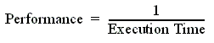
Comparing Performance
Often, we want to compare the performance of different machines or different programs. Why?
To help engineers understand which is “better”
To give marketing a “silver bullet” for the press release
To help customers understand why they should buy <my machine>
Performance and Execution time are reciprocals
Maximizing performance means minimizing response (execution) time

Slide 64

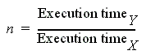
Common used phrases
“Performance of P₁ is better than P₂ ” is, for a given work load L, P₁ takes less time to execute L than P₂ does
performance(P1) > Performance(P2)
⇒ Execution Time(P1, L) < Execution Time(P1, L)
“Processor X is n times fast than Y” is

Slide 65
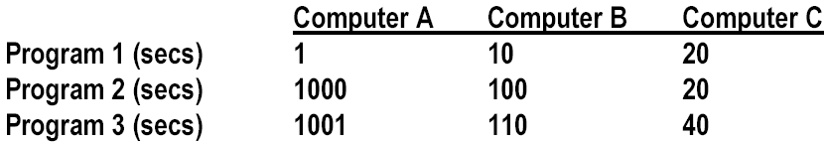
Comparing Performance Across Multiple Programs
A is 10 times faster than B for program 1
B is 10 times faster than A for program 2
A is 20 times faster than C for program 1
C is 50 times faster than A for program 2
B is 2 times faster than C for program 1
C is 5 times faster than B for program 2
Each statement above is correct…,
…but we want to know which machine is the best?

Slide 66
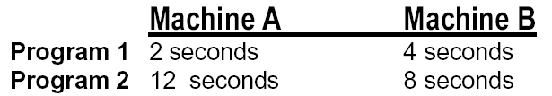
Let’s Try a Simpler Example
Two machines timed on two benchmarks
How much faster is Machine A than Machine B?
Attempt 1: ratio of run times, normalized to Machine A times
program1: 4/2 program2 : 8/12
Machine A ran 2 times faster on program 1, 2/3 times faster on program 2
On average, Machine A is (2 + 2/3) /2 = 4/3 times faster than Machine B
It turns this “averaging” stuff can fool us

Slide 67
Example: Second answer
Two machines timed on two benchmarks
How much faster is Machine A than Machine B?
Attempt 2: ratio of run times, normalized to Machine B times
program 1: 2/4 program 2 : 12/8
Machine A ran program 1 in 1/2 the time and program 2 in 3/2 the time
On average, (1/2 + 3/2) / 2 = 1
Put another way, Machine A is 1.0 times faster than Machine B

Slide 68
Example: Third answer
Two machines timed on two benchmarks
How much faster is Machine A than Machine B?
Attempt 3: ratio of run times, aggregate (total sum) times,
Machine A took 14 seconds for both programs
Machine B took 12 seconds for both programs
Therefore, Machine A takes 14/12 of the time of Machine B
Put another way, Machine A is 6/7 faster than Machine B

Slide 69
Which is Right?
Question:
How can we get three different answers?
Solution
Because, while they are all reasonable calculations…
…each answers a different question
We need to be more precise in understanding and posing these performance & metric questions

Slide 70
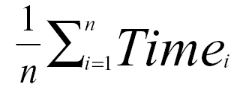
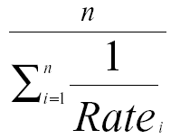
Arithmetic and Harmonic Mean
Total Execution Time: A Consistent Summary Measure
Arithmetic mean is the average of the execution time that tracks total execution time.
If performance is expressed as a rate, then the average that tracks total execution time is the harmonic mean
Notes:
harmonic [hɑ:'mɔnik]
adj. 和声的；谐和的；音乐般的
n. [物] 谐波；和声

Slide 71
Problems with Arithmetic Mean
Applications do not have the same probability of being run
Longer programs weigh more heavily in the average
For example, two machines timed on two benchmarks
Machine A Machine B
Program 1 2 seconds (20%) 4 seconds (20%)
Program 2 12 seconds (80%) 8 seconds (80%)
If we do arithmetic mean, Program 2 “counts more” than Program 1
an improvement in Program 2 changes the average more than a proportional improvement in Program 1
But perhaps Program 2 is 4 times more likely to run than Program 1

Slide 72
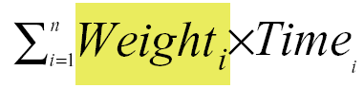
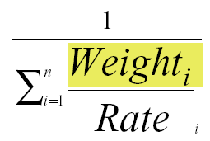
Weighted Execution Time
Often, one runs some programs more often than others. Therefore, we should weight the more frequently used programs’ execution time
Weighted Harmonic Mean

Slide 73
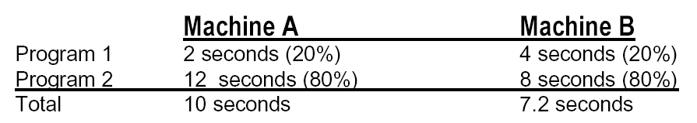
Using a Weighted Sum (or weighted average)
Allows us to determine relative performance 10/7.2 = 1.38
--> Machine B is 1.38 times faster than Machine A

Slide 74
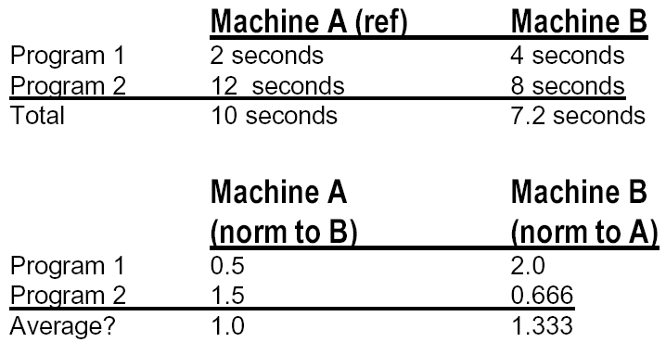
Another Solution
Normalize run time of each program to a reference
So when we normalize A to B, and average, it looks like A & B are the same.
But when we normalize B to A, it looks like B is 33% better!

Slide 75
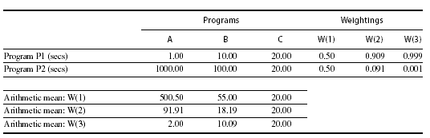
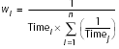
Example
33744 1
W(B)₁= ⎯⎯⎯⎯⎯⎯⎯⎯⎯ = 0.909
10×(1/10＋1/100)
1
W(B)2= ⎯⎯⎯⎯⎯⎯⎯⎯⎯ = 0.091
100×(1/10＋1/100)
Equal-time weighting

Slide 76
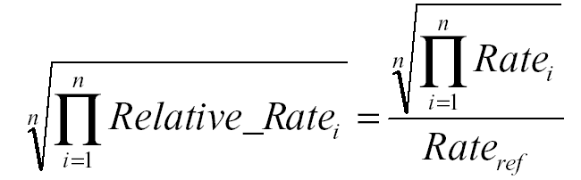
Geometric Mean
Used for relative rate or performance numbers
Geometric mean’s nice property
Geometric mean(Xi) Xi
Geometric mean(Yi) Yi
=Geometric mean( )

Slide 77
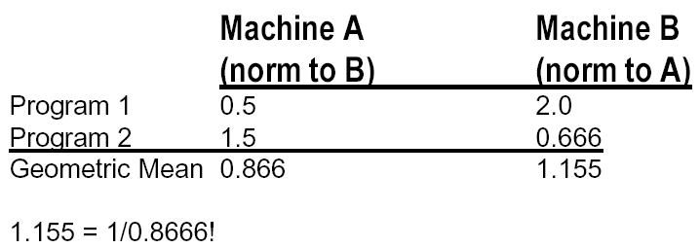
Using Geometric Mean
Drawback:
Geometric mean does NOT predict run time
Normalizes.
Each application now counts equally.
Advantage: Irrelevance of the reference computer in relative performance

Slide 78
Summary of comparing performance
Total execution time or arithmetic mean
consistent result
programs in the workload are NOT always run an equal number of times
Weighted arithmetic mean
take into account the frequency of use in the workload
solution depends on which machine is the reference.
Normalized Geometric Mean---SPEC Ratio
consistent result, no matter which machine is the reference.
Geometric mean does NOT predict run time
Ideal solution : Measure a real workload and weight the programs according to their frequency of execution.
What really matters is how YOUR application performs

Slide 79
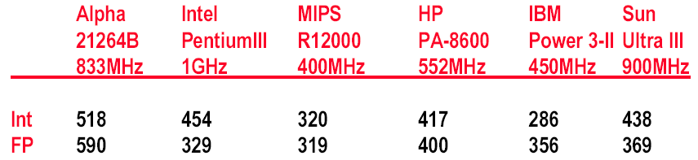
New SPEC Performance Numbers
Geometric Mean of 12 (SpecInt) and 14 (SpecFP) Benchmarks
Performance measured against SPARC 10/40
2000 Performance Numbers (Microprocessor Report, Dec. 2000)

Slide 80
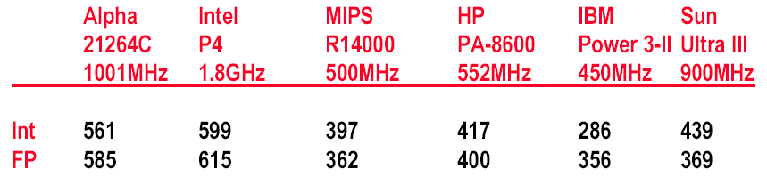
New SPEC Performance Numbers
Geometric Mean of 12 (SpecInt) and 14 (SpecFP) Benchmarks
Performance measured against SPARC 10/40
2001 Performance Numbers (Microprocessor Report, Aug. 2001)

Slide 81
Homework for Chapter 1
Read the section of 1.7(Putting it all together) and 1.9 (Fallacies and Pitfalls)
Due time: xxx, 11:55pm.
Do the homework in English.
Submit it to course website.
STID_name_hw1.pdf , NOT via email.
NOTES: do the homework not only for the score, but for your understanding of the contents.

